Slide 1
Unit Testing

Slide 2
Recap
Importance
Types and Description
Objectives
Challenges
Approaches
Unit Test Design
Best Practices

Slide 3
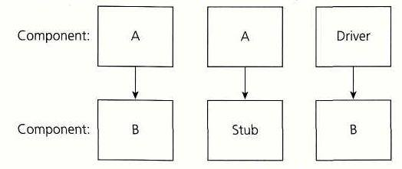
Mocks
An object under test may have dependencies on other (complex) objects. To isolate the behavior of the object you want to test you replace the other objects by mocks that simulate the behavior of the real objects.
This is useful if the real objects are impractical to incorporate into the unit test.
In short, mocking is creating objects that simulate the behavior of real objects.

Slide 4
Stubs and Drivers
Suppose you have a function (Function A) that calculates the total marks obtained. Suppose this function derives its values from another function (Function b) which calculates the marks obtained in a particular subject. Only Function A is finished and needs to be tested, but Function B is under Development. In this case, you create a dummy function to act in place of Function B to test your function A. This dummy function gets called by function A. Such a dummy is called a STUB. Suppose you have finished Function B and is waiting for Function A to be developed. In this case you create a dummy to call the Function B. This dummy is called the DRIVER.

Slide 5
Leveraging tools
leverage is any strategic or tactical advantage, and as a verb, means to exploit such an advantage, just as the use of a physical lever gives one an advantage in the physical sense.
Few Leveraging tools are :
MOQ, Nunit etc.

Slide 6
MOQ
Mocking framework for C#/.NET. It is used in unit testing to isolate your class under test from its dependencies and ensure that the proper methods on the dependent objects are being called.
If we have components which depend on external dependencies e.g. WCF Services, Databases etc. In such cases, the unit test needs to make calls to the WCF services or to a database. In unit testing, our main objective is to test the functionality of the component and it is difficult to reproduce WCF Service Proxy or the database calls.
For example, if we have an interface IUserDataAccess that is implemented by the class UserDataAccess which contains methods that make call to the entity framework and hence the database. We can use the interface top build a fake object using Mock<T> generic class.
Example: var repository=new Mock<IUserDataAccess<User>>();
var user = new User(repository.Object);

Slide 7
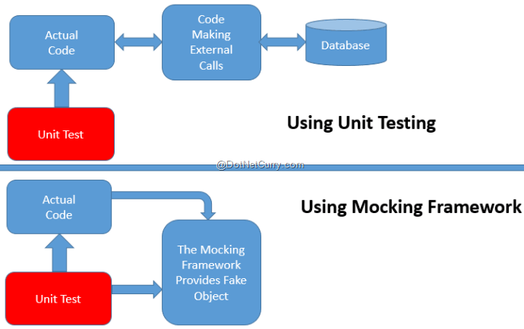
Mocking

Slide 8
NUnit
NUnit is a unit-testing framework for .NET applications in which the entire application is isolated into diverse modules.
Each module is tested independently to ensure that the objective is met.
The NUnit Framework caters a range of attributes that are used during unit tests.
They are used to define :
Test -Fixtures,
Test methods,
Expected Exception and
Ignore methods.

Slide 9
NUnit Attributes
Text Fixture Attribute : The Test Fixture attribute is an indication that a class contains test methods.
Test Attribute : The Test attribute indicates that a method within a test fixture should be run by the Test Runner application.
Expected Exception Attribute : But sometimes you have some circumstances where you actually want to ensure that an exception occurs.
Ignore Attribute :The Ignore attribute is required to indicate that a test should not be run on a particular method.
[TestFixture] public class Program { [Test] [ExpectedException(typeof(DivideByZeroException))] public void Test() { int i=10,j=0,x; x = i / j; }
[Test]
[Ignore("This method is skipping")]
public void Test1()
{
…
} }

Slide 10
Partial Mocks
Creating Partial Mocks :
Partial mocks are useful when you only need to mock several methods of an object leaving the remainder free to respond to calls normally (i.e. as implemented).
Mockery implements three distinct strategies for creating partials. Which strategy you use will depend on your own preferences and the source code in need of mocking
Traditional Partial Mock : A traditional partial mock, defines ahead of time which methods of a class are to be mocked and which are to be left unmocked (i.e. callable as normal).
$mock = \Mockery::mock('MyClass[foo,bar]');
Passive Partial Mock :A passive partial mock is more of a default state of being.
If you have no matching expectation for a specific method call, that call is deferred to the class being mocked.
$mock = \Mockery::mock('MyClass')->makePartial();
Proxied Partial Mock : A proxied partial mock is a partial of last resort. You may encounter a class which is simply not capable of being mocked because it has been marked as final.
$mock = \Mockery::mock(new MyClass);

Slide 11
Unit Test Execution Approach
A coder may use a Unit Test Framework to develop automated test cases. Using an automation framework, the developer codes criteria into the test to verify the correctness of the unit.
During execution of the test cases, the framework logs those that fail any criterion.
Many frameworks will also automatically flag and report in a summary these failed test cases.
Unit testing relies on mock objects being created to test sections of code that are not yet part of a complete application. Mock objects fill in for the missing parts of the program.

Slide 12
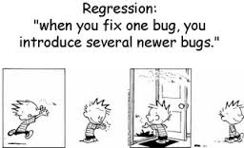
Regression Testing
It verifies that software previously developed and tested still performs correctly even after it was changed or interfaced with other software. Changes may include software enhancements, patches, configuration changes, etc.
During regression testing, new software bugs or regressions may be uncovered. Sometimes a software change impact analysis is performed to determine what areas could be affected by the proposed changes.

Slide 13
Test Driven Development
The first step is to quickly add a test, basically just enough code to fail.
Next you run your tests, often the complete test suite although for sake of speed you may decide to run only a subset, to ensure that the new test does in fact fail.
You then update your functional code to make it pass the new tests.
The fourth step is to run your tests again. If they fail you need to update your functional code and retest. Once the tests pass the next step is to start
There are two levels of TDD:
Acceptance TDD (ATDD).
Developer TDD.

Slide 14
Test Driven Development
Acceptance TDD (ATDD) : With ATDD you write a single acceptance test, or behavioral specification depending on your preferred terminology, and then just enough production functionality/code to fulfill that test.
The goal of ATDD is to specify detailed, executable requirements for your solution on a just in time (JIT) basis. ATDD is also called Behavior Driven Development (BDD).
Developer TDD : With developer TDD you write a single developer test, sometimes inaccurately referred to as a unit test, and then just enough production code to fulfill that test.
The goal of developer TDD is to specify a detailed, executable design for your solution on a JIT basis. Developer TDD is often simply called TDD.

Slide 15
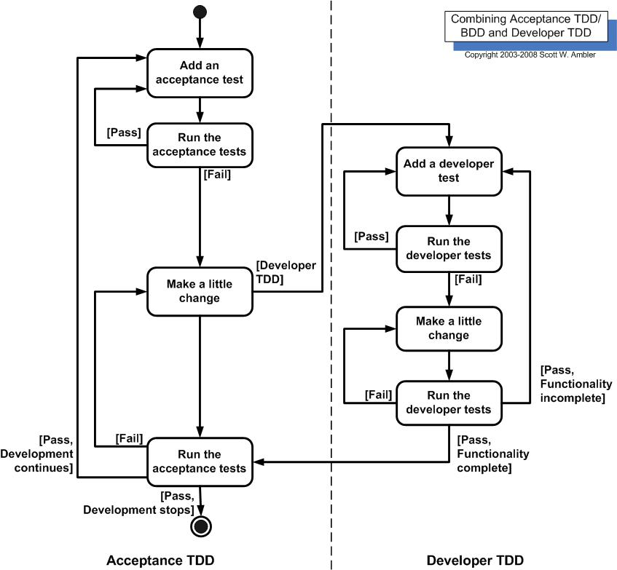
Test Driven Development

Slide 16
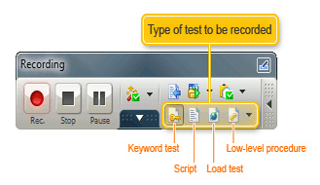
Unit Test Automation-Record/Capture and Playback
The automated test tools perform actions on UI objects. These actions are performed by running a script. Scripts may be recordings of user actions. They may have been programmed (or scripted) manually in the language of the test tool.
The test tool is set to record mode and the user performs actions on the SUT(System under test).
In the application under test - Select menu items, type text, choose values from combo boxes, press buttons - and all your actions are recorded as automated test commands.

Slide 17
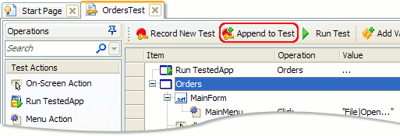
Automated Unit Test Execution with Capturing of test results
The recording or script will consist of a list of actions. These can then be replayed back into the SUT’s UI, thereby executing tests against the system.
For example,
# Login set_window ("Login", 2); edit_set ("txtUserName", "JohnSmith"); password_edit_set("txtPassword",
"hygsfzgsbzotmyisivjs"); button_press ("OK");
The above recorded test can be Played back by selecting the “Append to test” option .

Slide 18
Integrating Automation Suite within Source Control
Having a solid source control system is essential to any software development project.
Not only does it provide you with history tracking of who made changes and what the changes were, but it also gives you one centralized source for all your code, which can save you hours of rework and troubleshooting if something goes wrong. Additionally, it allows for easy collaboration across teams who might have specific knowledge about one piece of the automation pipeline.
Automations can describe complex processes that are mission critical to the business so they should be managed just like any other deployed software.
Continuous Integration is a software development practice where members of a team integrate their work frequently, usually each person integrates at least daily - leading to multiple integrations per day. Each integration is verified by an automated build (including test) to detect integration errors as quickly as possible.

Slide 19
Approach towards Defect Management, Metrics and Reporting
It is important that the defect information, which is a natural by-product of the defect management process, be analyzed and communicated to both project management and senior management.
This could take the form of defect rates, defect trends, types of defects, failure costs, etc.
From a tactical perspective, defect arrival rate (rate at which new defects are being discovered) is a very useful metric that provides insight into a project's likelihood of making its target date objectives.
Defect removal efficiency is also considered to be one of the most useful metrics, however it can not be calculated until the system is installed.

Slide 20


